Slide 1
Pitfalls and difficulties in HTT SM modulators research
----1st part
April 28, 2023
Introduction
Zhen, Dann, Joon, Magnus, Jessica, Christina

Slide 2
Tools
On-Target
Off-Targets

Slide 3
TST11872 Study design
New data (4/02/22)
Compound | CRL HTRF IC50 (nM) | Internal HTRF IC50 (nM) | Internal iPSC qPCR IC50 (nM) | Internal NGN2 qPCR IC50 (nM) | ~3x IC50 Dose (nM) | Actual X-fold IC50 (iPSC) | Actual X-fold IC50 (NGN2) | ~10x IC50 Dose (nM) | Actual X-fold IC50 (iPSC) | Actual X-fold IC50 (NGN2) | Notes
BIO-1755497 | 121 | 4 | 10.75 | 3 | 12 | 1.12 | 4.00 | 40 | 3.72 | 13.33 | Branaplam
BIO-2006152 | 87 | 15 | 14.26 | 9.1 | 45 | 3.16 | 4.95 | 150 | 10.52 | 16.48 | ~PTC-518
BIO-2059811 | 87 | Expected <100nM | 101.5 | 65.19 | 261 | 2.57 | 4.00 | 870 | 8.57 | 13.35 | PTC different core
BIO-2135644 | 100 | Expected <100nM | 81.68 | 68.31 | 300 | 3.67 | 4.39 | 1000 | 12.24 | 14.64 | PTC different core
BIO-2136770 | 100 | Expected <100nM | 41 | 24.59 | 300 | 7.32 | 12.20 | 1000 | 24.39 | 40.67 | Close PTC518 analog
BIO-1949634 | 1500 | 6200 | 357.55 | 324.6 | 3000 | 8.39 | 9.24 | 10000 | 27.97 | 30.81 | Risdiplam
BIO-2060573 | 5780 | 670 | 298.2 | 271.5 | 3000 | 10.06 | 11.05 | 10000 | 33.53 | 36.83 | Internal lead/different core
BIO-2070692 | 560 | 50 | 140.4 | 104.4 | 1680 | 11.97 | 16.09 | 5600 | 39.89 | 53.64 | Remix example
BIO-2060884 | 370 | 240 | 77.9 | 105.9 | 3700 | 47.50 | 34.94 | 10000 | 128.37 | 94.43 | Internal lead
DMSO | - | - | - | - | - | - |  | -
Strategies for comparison:
Comp1: NGN2 ~4x
BIO-1755497 (Bran) NGN2, Low (4x)
BIO-2006152 (PTC-518) NGN2, Low (5x)
BIO-2059811 (PTC) NGN2, Low (4x)
BIO-2135644 (PTC) NGN2, Low (4.4x)
Catherine
Comp2: NGN2 ~9-16x
BIO-1755497 (Bran) NGN2, High (13x)
BIO-2006152 (PTC-518) NGN2, High (16.5x)
BIO-2059811 (PTC) NGN2, High (13.3x)
BIO-2135644 (PTC) NGN2, High (14.5x)
BIO-2136770 (PTC) NGN2, Low (12x)
BIO-1949634 (Ris) NGN2, Low (9x)
BIO-2060573 (Internal) NGN2, Low (11x)
BIO-2070692 (Remix) NGN2, Low (16x)
Comp3: iPSC ~7-10x
BIO-2006152 (PTC-518) iPSC, High (10x)
BIO-2059811 (PTC) iPSC, High (8.5x)
BIO-2135644 (PTC) iPSC, High (12.2x)
BIO-2136770 (PTC) iPSC, Low (7x)
BIO-1949634 (Ris) iPSC, Low (9x)
BIO-2060573 (Internal) iPSC, Low (10x)
BIO-2070692 (Remix) iPSC, Low (12x)
Comp4: iPSC ~2-4x
BIO-1755497 (Bran) iPSC, High (4x)
BIO-2006152 (PTC-518) iPSC, Low (3x)
BIO-2059811 (PTC) iPSC, Low (2.6x)
BIO-2135644 (PTC) iPSC, Low (4x)

Slide 4
The target region
OneDrive-Biogen/Meetings/TST12086/plots/Magnus_requested/2023_04_24_Requested/HTT/
https://biib-my.sharepoint.com/:f:/g/personal/zhen_gao_biogen_com/Eu3PZgm1y8BJmQKbgz3RXt0B3ZRHyHrPhI-EtLCaKUmnLw

Slide 5
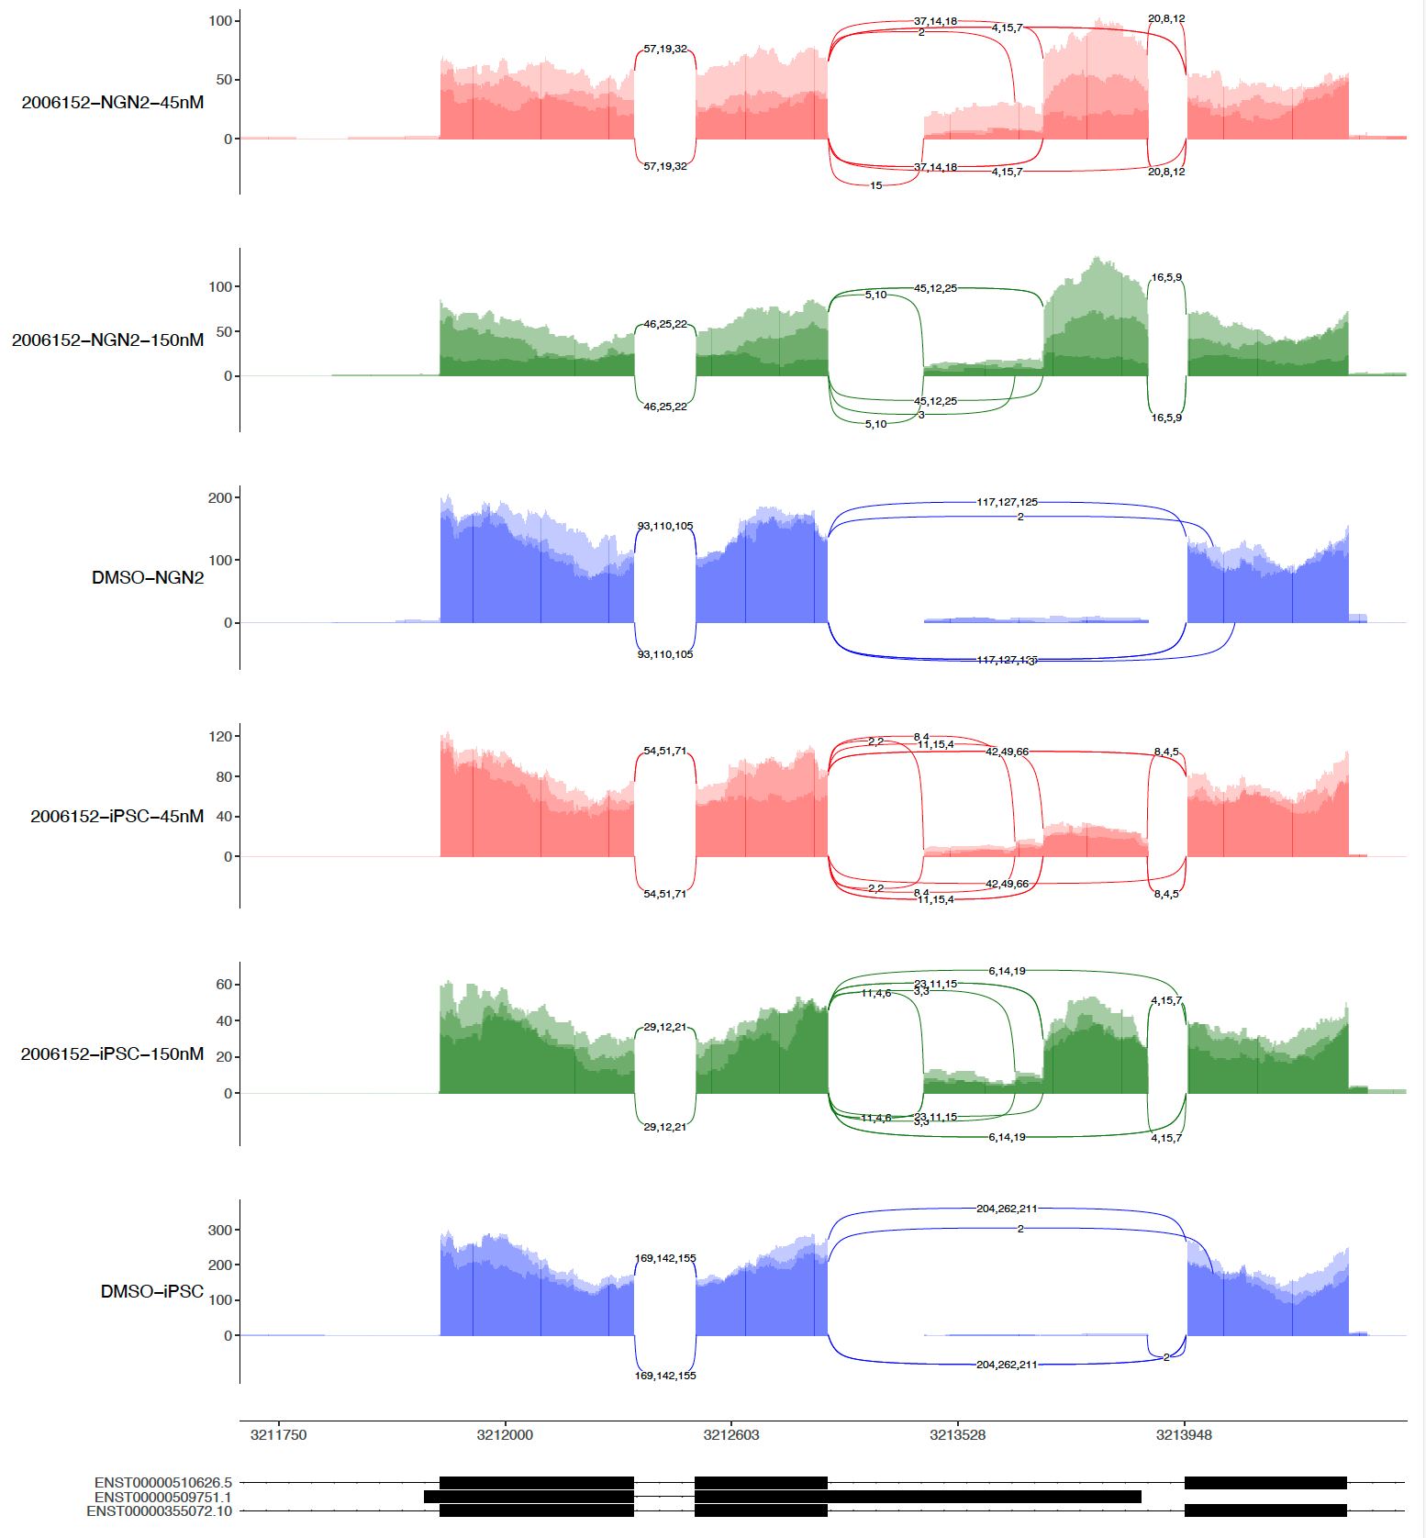
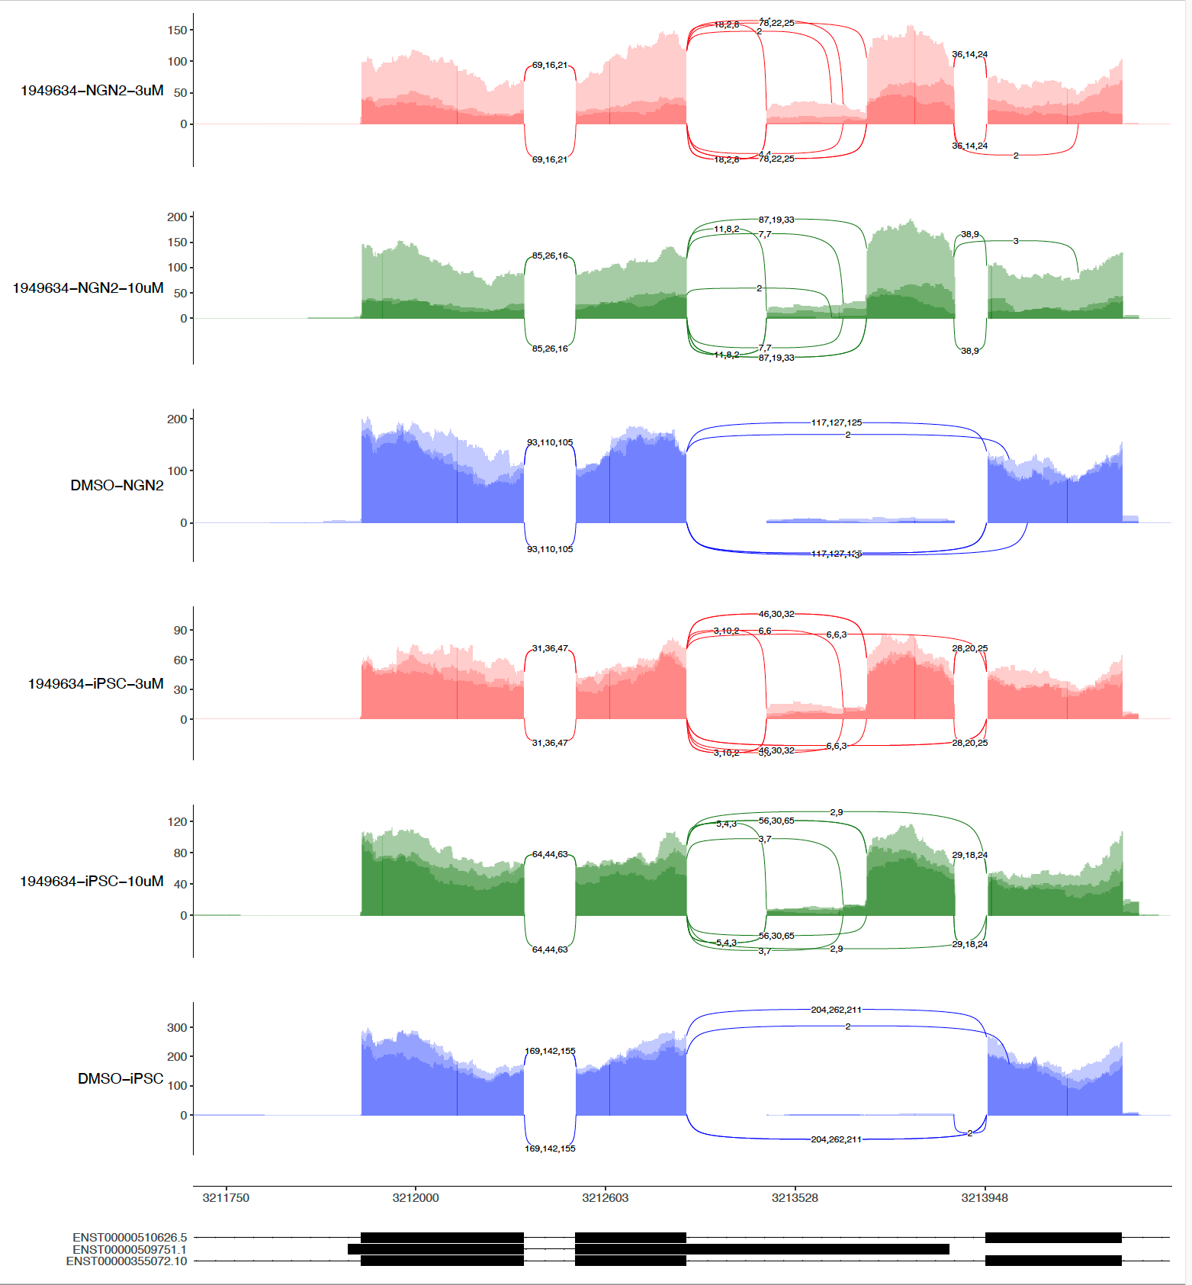
sashimi-plots: 1st 6152 and 9634

Slide 6
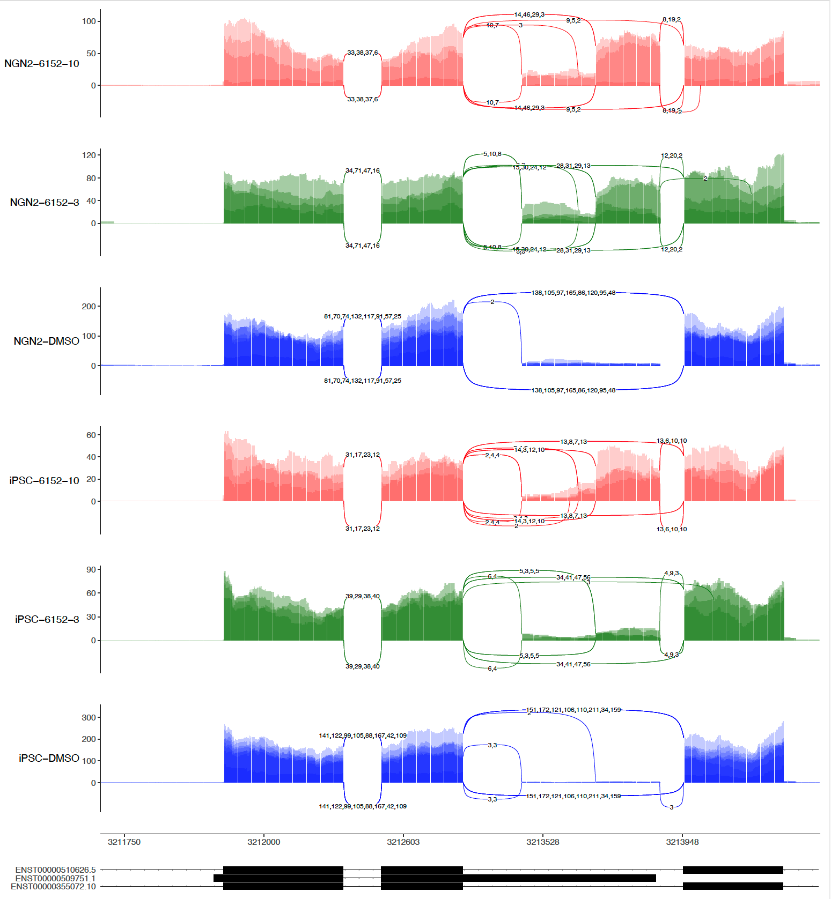
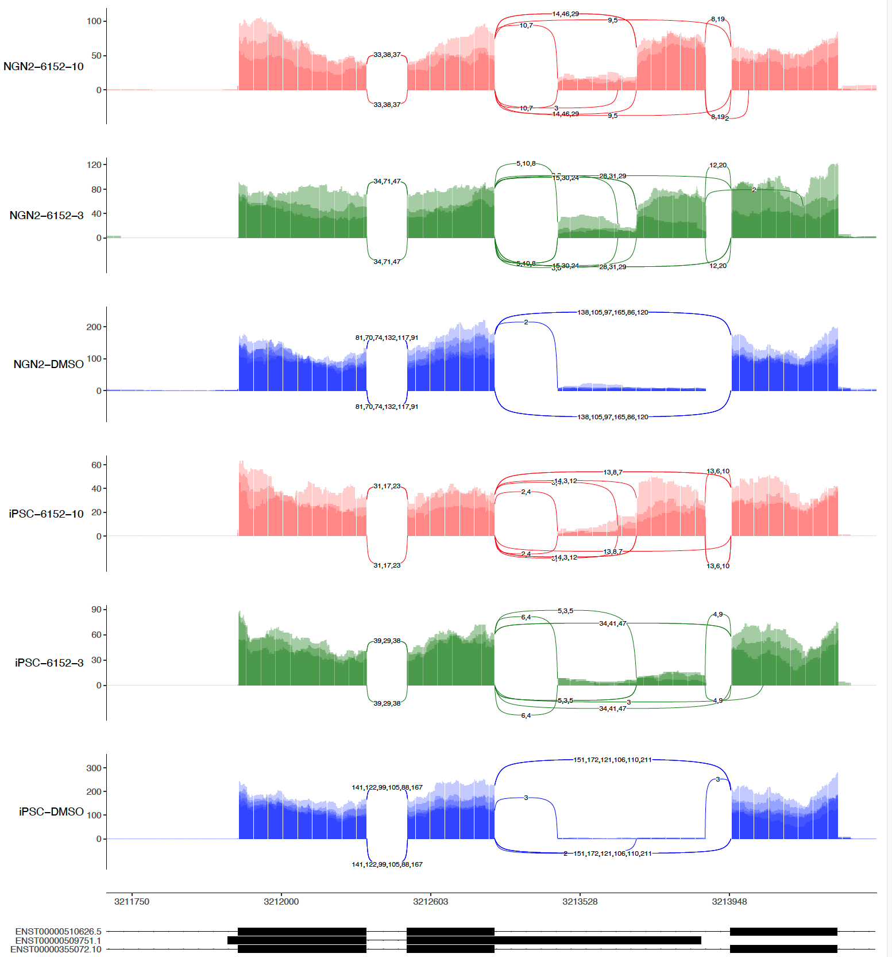
sashimi-plots: 2nd 6152
4 repeats
3 repeats (No R4)

Slide 7
2136770 (1000nM) in iPSC(Left) and NGN2(Right)

Slide 8
It looks more than toxic exon spicing in
Classical toxic exon splicing in type
48
49
49N
50
51
Ex49N: chr4:3,213,622-3,213,736 (+)
Non-Classical but high frequent ones
48
49
49N
Intron
50
51
Non-Classical and less frequent ones
48
49
49N
Intron
50
51
Nonsense-mediated mRNA decay (NMD)
Edited from Jessica Plots

Slide 9
Tools

Slide 10
The difference in SMN2 dPSI between algorithms comes from varying definitions of “PSI”
rMATS : does not even use the word PSI, just called “Inclusion Level Difference”
Leafcutter: “Percent Spliced In”
Majiq: “Percent Selected Index” (one junction at a time)
<DMSO>
<RG7916>
C₁=16
C₃=29
C₁=54
C₃=79
Example:
Delta
C₂=20
C₂=0
rMATS
C₁+C₃
C₁+2*C₂+C₃
0.53
1.0
0.47
Leafcutter
C₁+C₃
C₁+C₂+C₃
0.69
1.0
0.31
Majiq
C₁ C₃
C₁+C₂ C₂+C₃
Slide From Dann
or
0.44 or 0.59
1 or 1
0.56 or 0.41

Slide 11
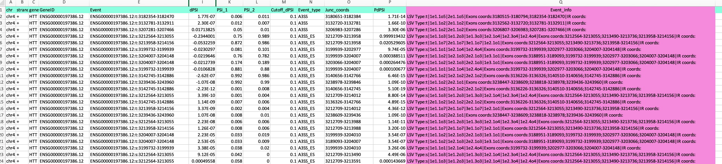
Sample Output

Slide 12
Sample Output:event_info
LSV Type:t|1e1.1o5|2e1.1o5|Exons coords:3180515-3180794;3182354-3182470|IR coords:
LSV Type:t|1e1.1o2|2e1.1o2|Exons coords:3132562-3132720;3132781-3132911|IR coords:
LSV Type:t|1e1.1o2|2e1.1o2|Exons coords:3206807-3206983;3207281-3207466|IR coords:
LSV Type:s|1e1.1o3|1e1.2o3|1e1.3o3|1e2.1o4|1e2.3o4|1e2.4o4|Exons coords:3212564-3213055;3213490-3213736;3213958-3214156|IR coords:
LSV Type:t|1e1.1o7|2e1.1o7|3e1.1o7|1e2.1o1|Exons coords:3212564-3213055;3213490-3213736;3213958-3214156|IR coords:
LSV Type:s|1e1.1o1|1e2.1o4|1e2.4o4|Exons coords:3199732-3199939;3202977-3203066;3204007-3204148|IR coords:
LSV Type:t|1e1.1o2|1e2.1o3|2e2.1o3|1e3.1o1|Exons coords:3188951-3189093;3199732-3199939;3202977-3203066;3204007-3204148|IR coords:
LSV Type:t|1e1.1o2|1e2.1o3|2e2.1o3|1e3.1o1|Exons coords:3188951-3189093;3199732-3199939;3202977-3203066;3204007-3204148|IR coords:
LSV Type:s|1e1.1o1|1e2.1o4|1e2.4o4|Exons coords:3199732-3199939;3202977-3203066;3204007-3204148|IR coords:
LSV Type:t|2e1.1o2|1e2.1o2|2e2.1o2|Exons coords:3136226-3136326;3140510-3140656;3142745-3142886|IR coords:
LSV Type:t|1e1.1o2|2e2.1o1|Exons coords:3238447-3238609;3238818-3238978;3239436-3243960|IR coords:
LSV Type:t|2e1.1o2|1e2.1o2|2e2.1o2|Exons coords:3136226-3136326;3140510-3140656;3142745-3142886|IR coords:
LSV Type:s|1e1.1o3|1e1.2o3|1e1.3o3|1e2.1o4|1e2.3o4|1e2.4o4|Exons coords:3212564-3213055;3213490-3213736;3213958-3214156|IR coords:
LSV Type:t|2e1.1o2|1e2.1o2|2e2.1o2|Exons coords:3136226-3136326;3140510-3140656;3142745-3142886|IR coords:
LSV Type:t|1e1.1o7|2e1.1o7|3e1.1o7|1e2.1o1|Exons coords:3212564-3213055;3213490-3213736;3213958-3214156|IR coords:
LSV Type:t|1e1.1o2|2e2.1o1|Exons coords:3238447-3238609;3238818-3238978;3239436-3243960|IR coords:
LSV Type:s|1e1.1o3|1e1.2o3|1e1.3o3|1e2.1o4|1e2.3o4|1e2.4o4|Exons coords:3212564-3213055;3213490-3213736;3213958-3214156|IR coords:

Slide 13
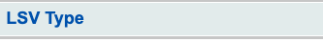
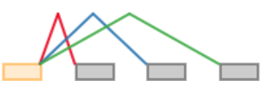
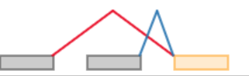
The central idea of MAJIQ: local splicing variations
(0) s|1e1.1o1|1e2.1o1|1e3.1o1
(1) t|1e1.1o1|1e2.1o1

Slide 14
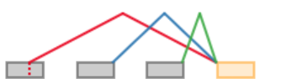
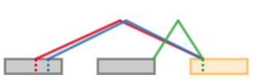
The central idea of MAJIQ: local splicing variations
(5) t|1e1.1o2|1e2.1o1|1e3.1o1
(9) t|2e1.1o3|2e1.2o3|2e2.1o1

Slide 15
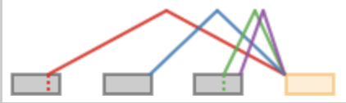
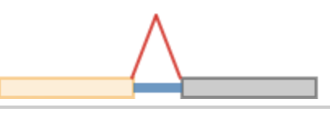
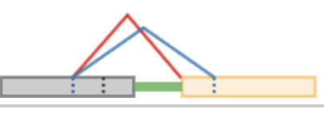
The central idea of MAJIQ: local splicing variations
(16) t|1e1.2o3|1e2.1o1|1e3.1o2|1e3.2o2
(135) s|1e1.1o1|i
(1572) t|1e1.1o3|2e1.1o3|i
t|2e1.1o1|3e1.1o1|3e2.1o2

Slide 16
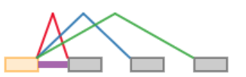
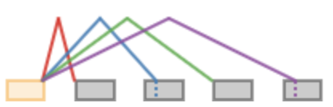
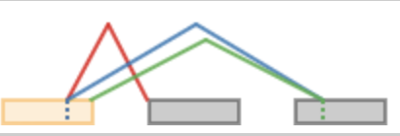
The central idea of MAJIQ: local splicing variations
(2) s|1e1.1o1|1e2.1o1|1e3.1o1|i
(13) s|1e1.1o1|1e2.2o2|1e3.1o1|1e4.2o2
(22) s|1e1.1o1|1e2.2o2|2e2.2o2

Slide 17
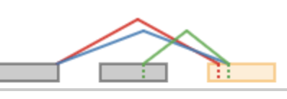
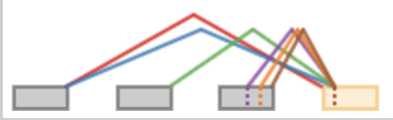
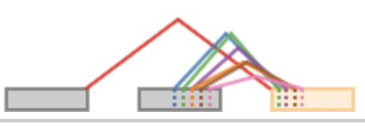
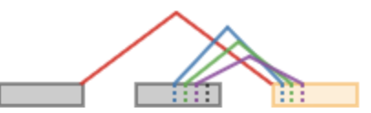
The central idea of MAJIQ: local splicing variations
(1573) t|2e1.1o1|3e1.1o1|3e2.1o2
(1638) t|1e1.1o1|2e1.1o1|2e2.1o1|2e3.1o3|2e3.2o3|2e3.3o3
(1645) t|1e1.1o1|2e2.1o6|2e2.2o6|3e2.3o6|4e2.3o6|4e2.4o6|5e2.5o6
(1779) t|1e1.1o1|2e2.1o5|3e2.2o5|4e2.3o5

Slide 18
The central idea of MAJIQ: local splicing variations
chr4 + HTT ENSG00000197386.12:s:3212564-3213055
LSV Type:s|1e1.1o3|1e1.2o3|1e1.3o3|1e2.1o4|1e2.3o4|1e2.4o4|
Exons coords:3212564-3213055;
3213490-3213736;
3213958-3214156
chr4 + HTT ENSG00000197386.12:t:3130305-3130423
LSV Type:t|1e1.1o4|1e1.2o4|1e1.3o4|i|
Exons coords:3128339-3130062;
3130063-3130304; 3130305-3130423|IR coords:3130063-3130304

Slide 19
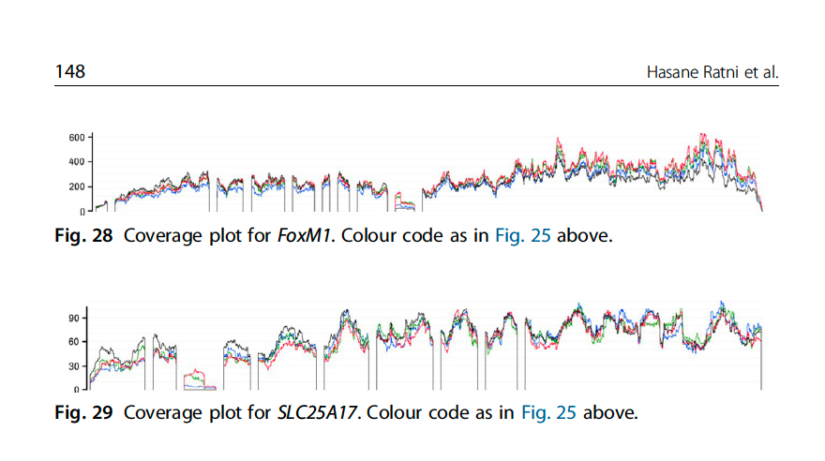
On-Targets and Off-Targets sequences
 | Doner Splice Site Consensus
 | AG|GURAGU
Gene Names | Risdiplam Consensus Binding sequence
SMN2 | GA|GTAAGT
APLP2 | GA|GTAAGT
FOXM1-inside | GA|GTAAGT
FOXM1-border | CA|GTAAGT
SLC25A17-inside | GA|GTAAGA
SLC25A17-border | AG|GTTAAA
(ref: Ratni Roche review, Progress Medicinal Chem V58, 2019)

Slide 20
Main Goals of the RNAseq
Discover the compounds have fewer off-targets and but strong on-target effects
Determine the common targets among the SM splicing enhancers
Explore potential novel splicing targets
Confirm the system difference between the different cell-systems (iPSC and NGN2)
Seek the best procedure for cross-experiments/cross-cell-systems comparison
Make robust and cost-efficient experimental design, QC etc.
Sep 26, 2022
Zhen, Dann, Catherine, Joon, Magnus, Jessica

Slide 21
Off-Targets
https://biib-my.sharepoint.com/:f:/g/personal/zhen_gao_biogen_com/EtKRSWvfucZPh73OPDE8GEQBS8sdt0s64LN2qI6kN6h_-w

Slide 22
The selected region

Slide 23
The selected region

Slide 24
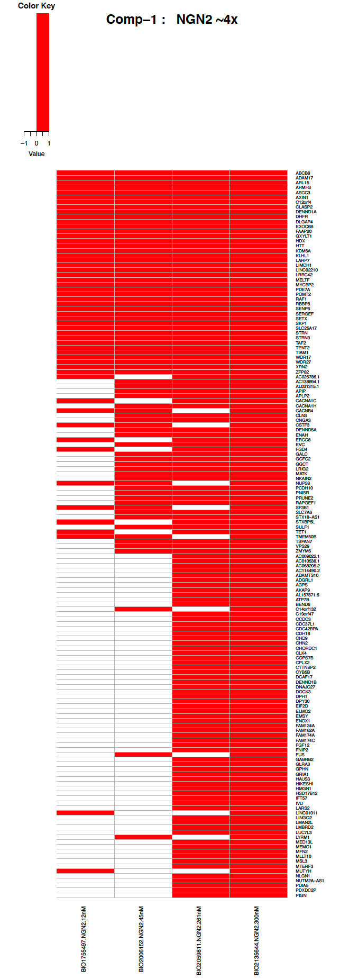
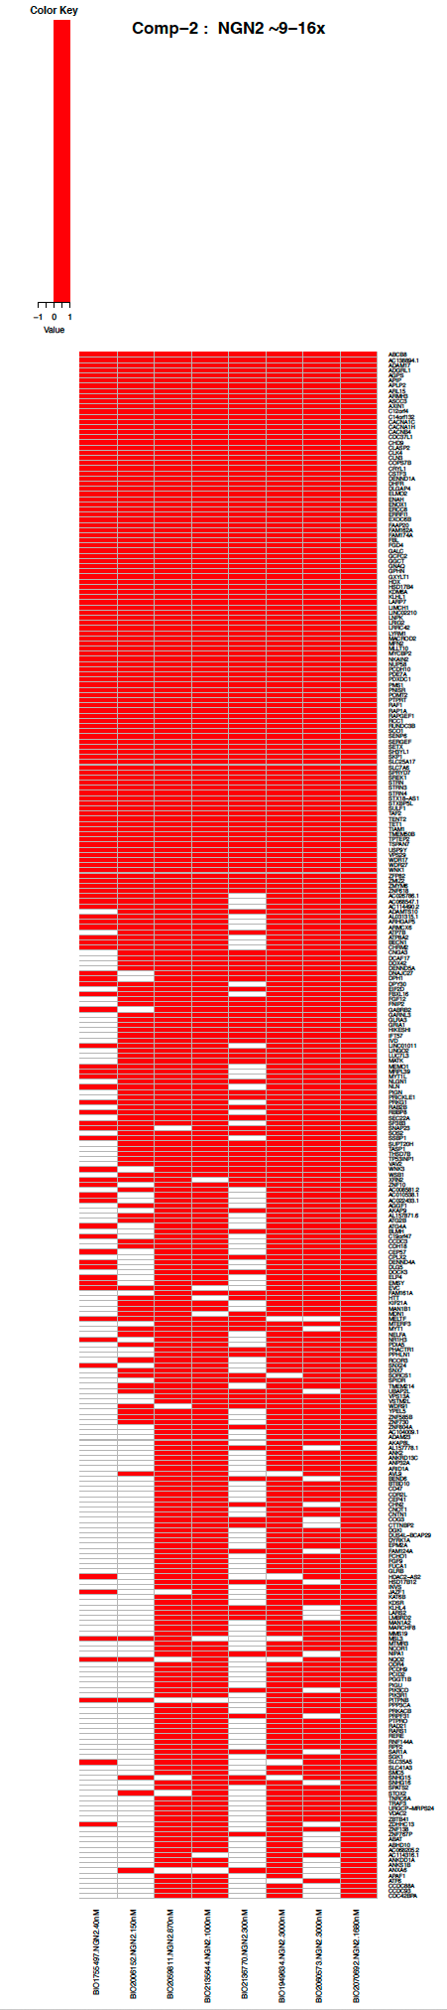
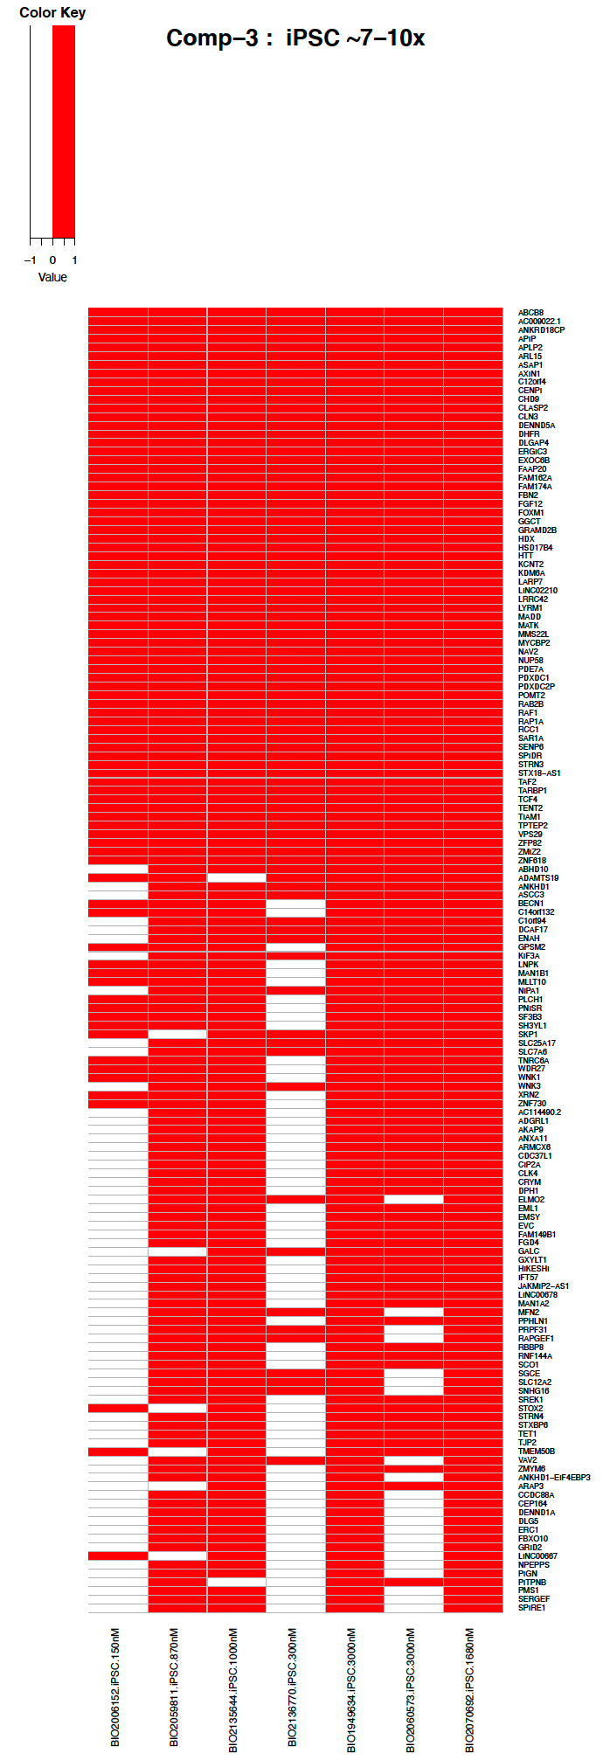
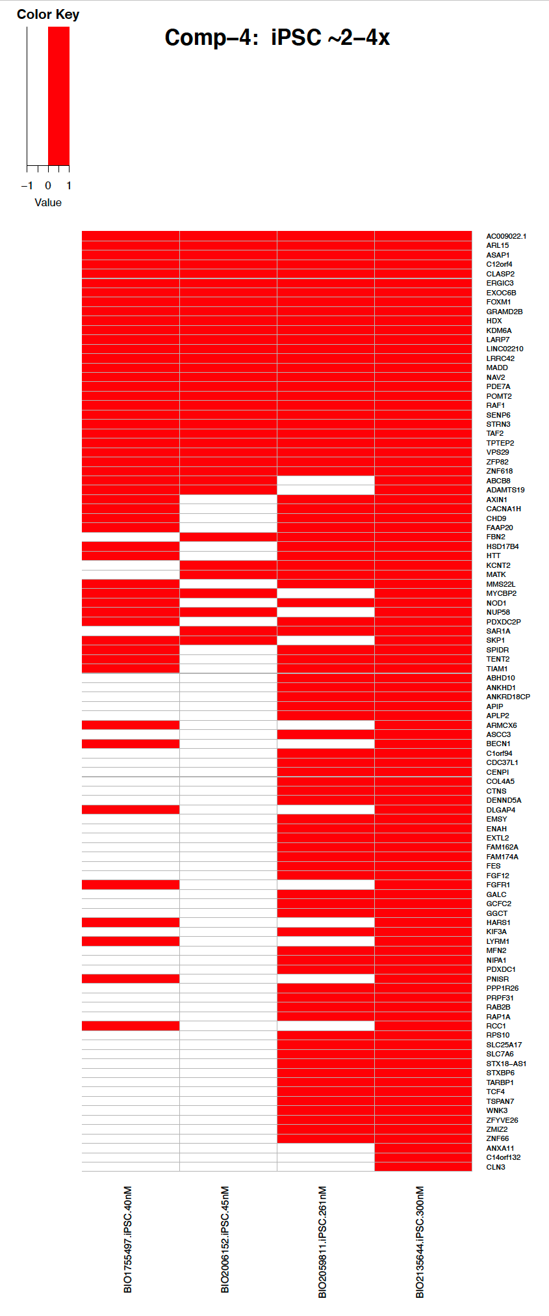
Branaplam and PTC518 benchmark RNA-seq data analysis

Slide 25
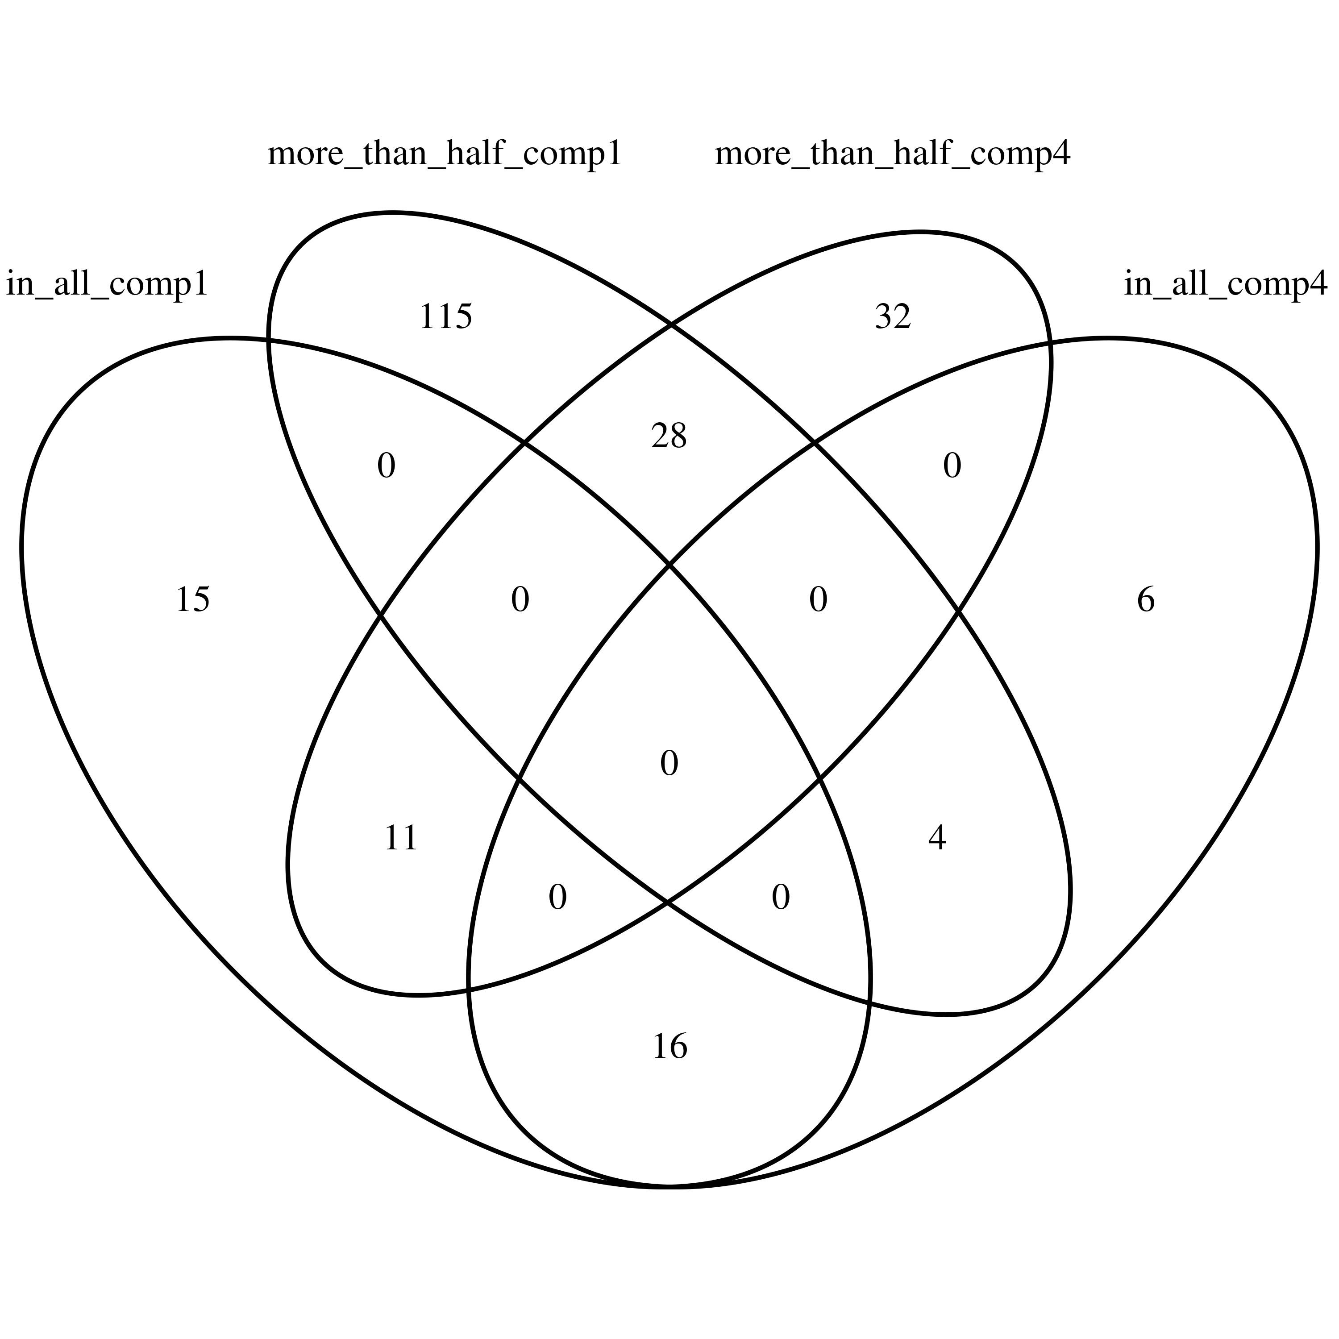
Venn Diagram

Slide 26
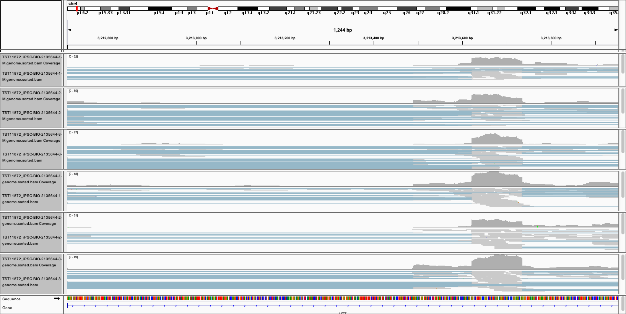
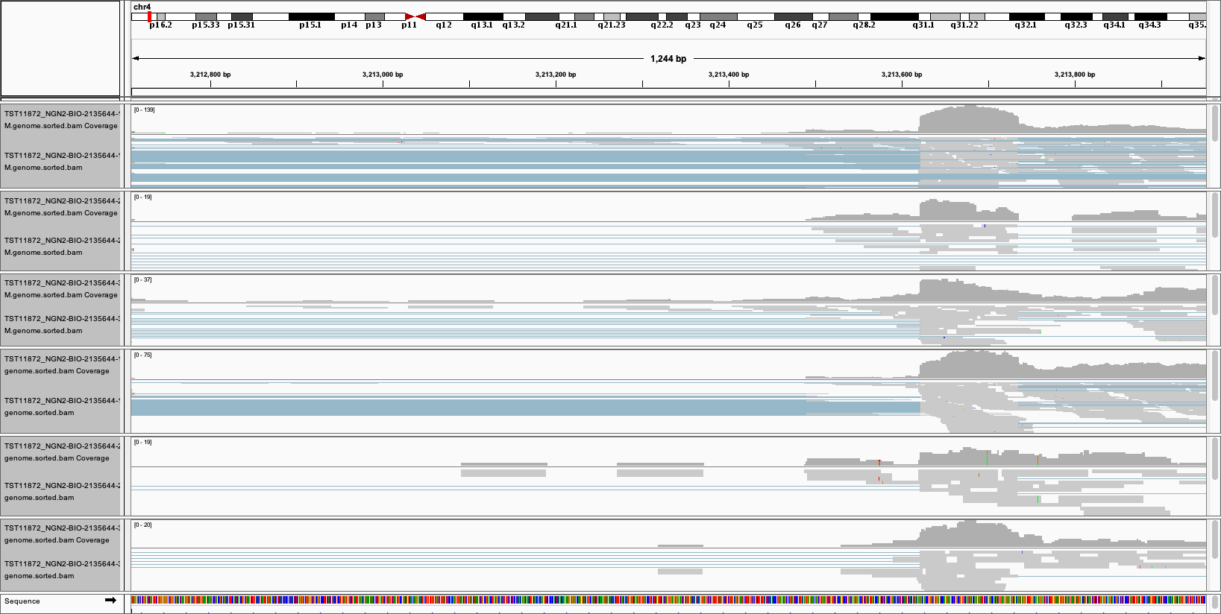
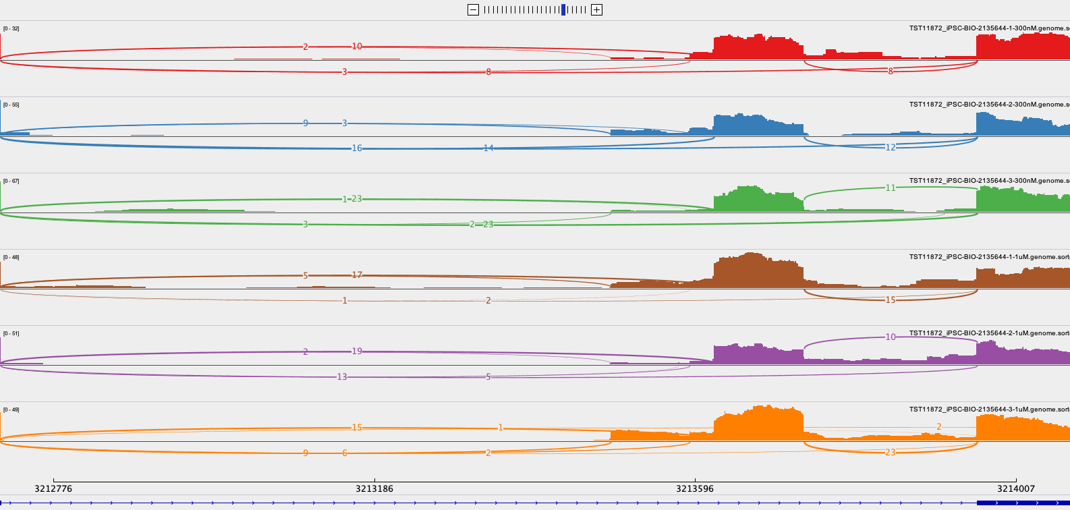
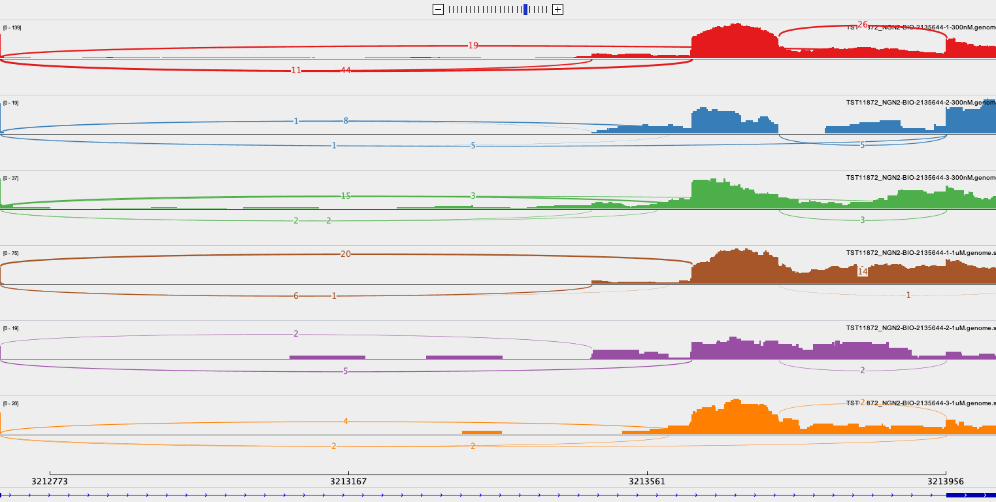
2135644 in iPSC and NGN2

Slide 27
2136770 (1000nM) in iPSC(Left) and NGN2(Right)

Slide 28
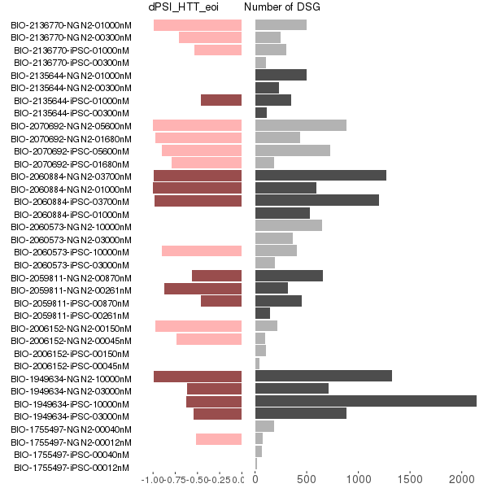
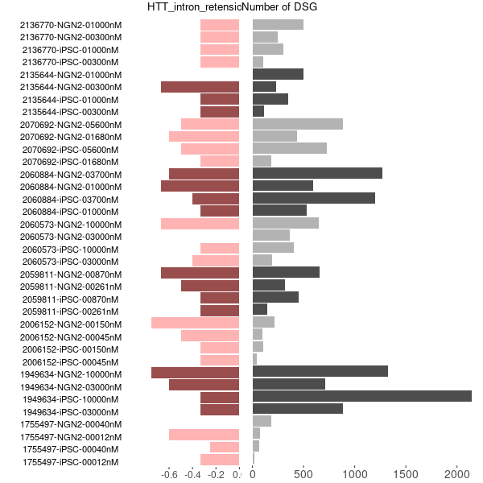
DSG and dPSI in eoi
dPSI from leafcutter
Intron_retension_rate (from majiq)

Slide 29


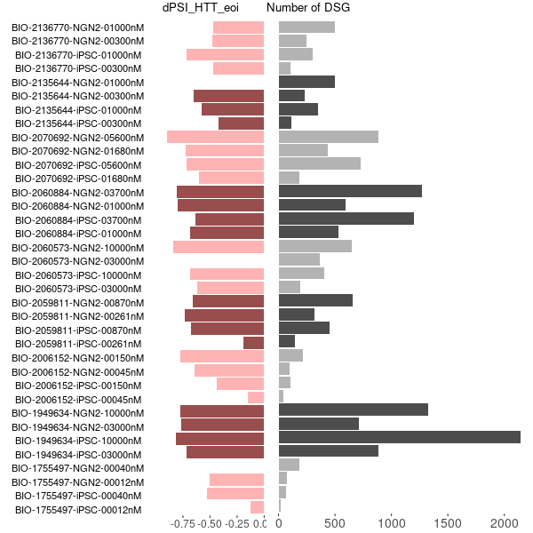
dPSI_of_eoi
dPSI
leafcutter-default
leafcutter-with-all-toxic-exon-forms
majiq-with-all-toxic-exon-forms

Slide 30
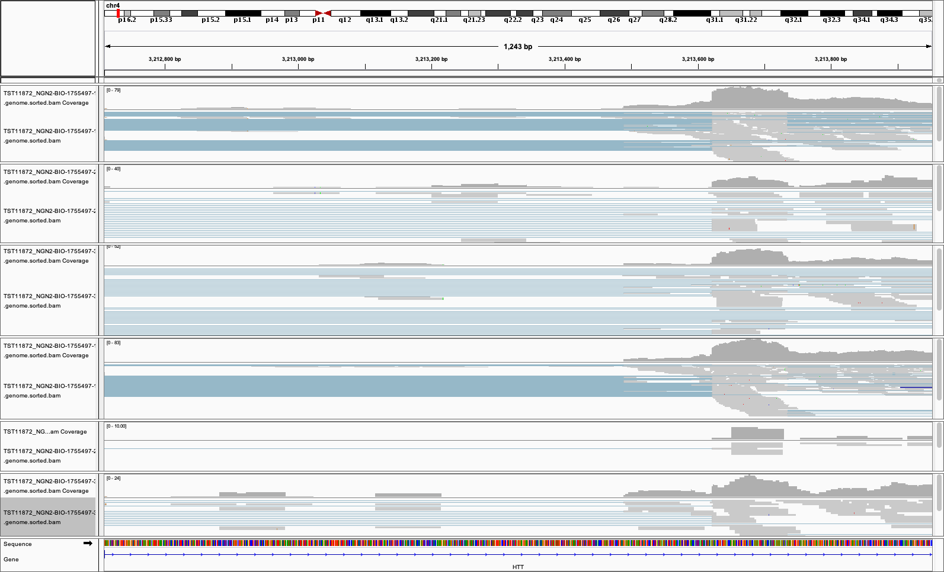
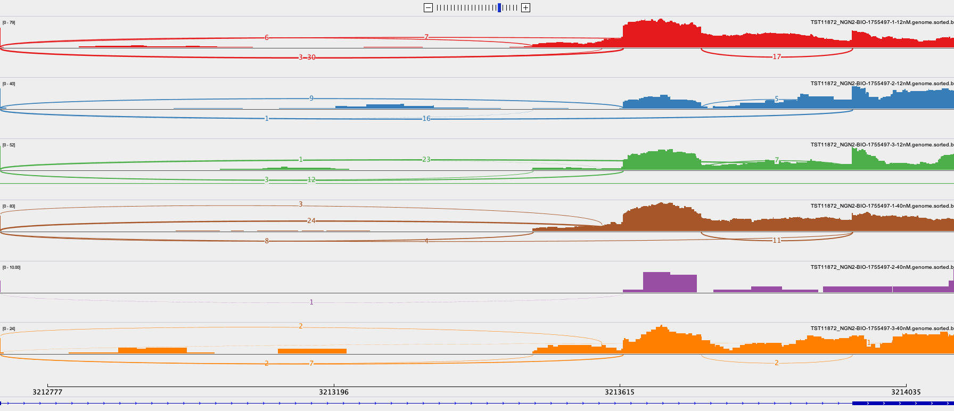
1755497 in NGN2

Slide 31
The motif analysis of selected regions

Slide 32
The selected region

Slide 33
The selected region

